Slide 1



Project 2 - Supply and Demand Gap Analysis
View in Power BI
Last data refresh:
15/06/2023 10:55:34 UTC
Downloaded at:
15/06/2023 11:00:23 UTC

Slide 2
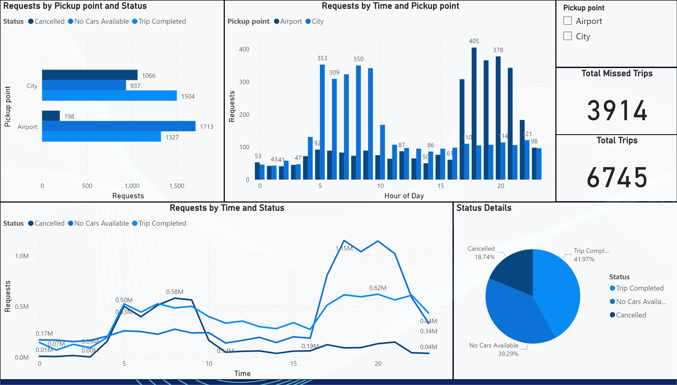
Dashboard_0
Notes:
Total Missed Trips
3914
Total Trips
6745

Slide 3
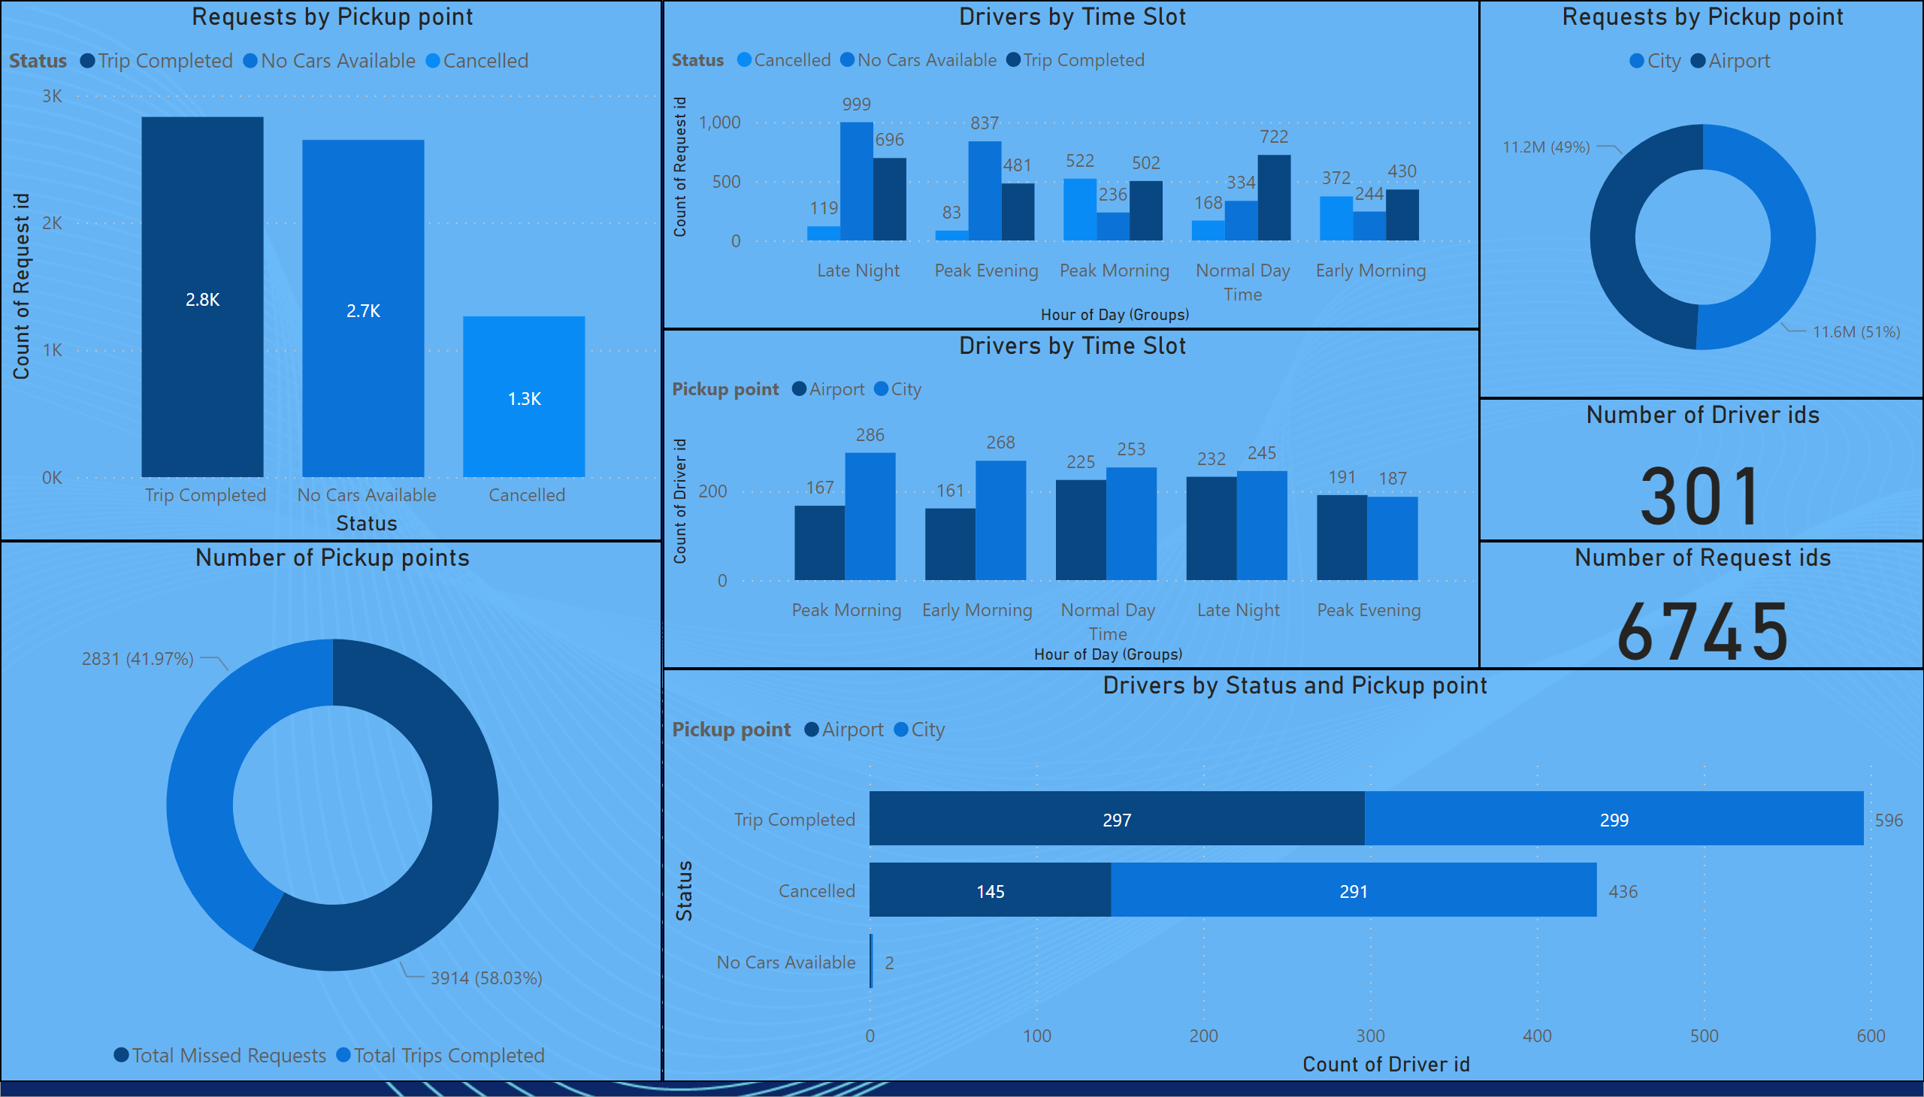
Dashboard_1
Notes:
Number of Request ids
6745
Number of Pickup points
2
Requests by Pickup point
6745
Number of Driver ids
301

